Slide 1
A Deep Learning Model for Long-Term Declarative Episodic Memory Storage
Prof. Charles Tappert, Abu Kamruzzaman, Yousef Alhwaiti,
Atik Khatri, Ajinkya Parkar, Damiano Mastrandrea,
Karan Thakkar, Milind Ikke, Poorva Shelke

Slide 2
Agenda
Introduction
Goal
User Stories
Project Requirements
Approach
Results
Setbacks & Difficulties

Slide 3
INTRODUCTION
What’s the buzz about?

Slide 4
Have you ever wondered about...
How you remember the times, places, associated emotions and other contextual knowledge at
Your first day at work/college/school.
The day when you experienced something new (your best/worst day in life?).
The day when you achieved something.
You can recall almost everything (When, where, how, who, why).

Slide 5
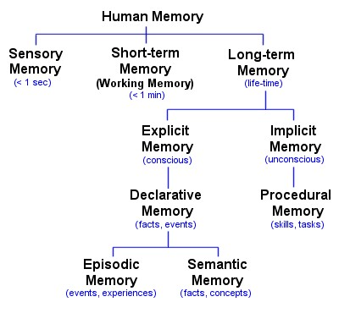
Why does that happen?
Human memory consists of different types of memories.
It happens because of the capability of human brain to store episodic memory.
Episodic memory represents our memory of experiences and specific events in time in a serial form, from which we can reconstruct the actual events that took place at any given point in our lives.
It is the memory of autobiographical events.

Slide 6
GOAL
To create a deep learning model which can replicate this episodic memory behaviour of the human brain.

Slide 7
User Stories
Data - Feed huge dataset to the model.
I/P - Send randomly selected continuous data from the dataset to model.
O/P - Let the model generate some specific data based on the I/P data.
Results - Check the generated data and compare it with the original data.
Tuning model - Train for more epochs on the data.
Comparision - Check results and compare with previous O/P.

Slide 8
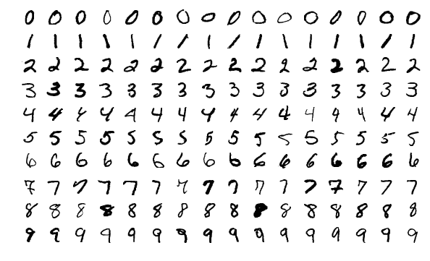
Project Requirements
MNIST - Handwritten Numbers Dataset
Deep Learning programming languages & Techniques:
Keras
Tensorflow
LSTM Model (Long Short Term Memory)

Slide 9
Approach
Training a LSTM model on the MNIST dataset.
Create samples of sequential data. (I/P + O/P)
Send only half of the data (I/P) to the model.
Let the model generate the other half (O/P).
Compare the results.
Get the accuracy.
Train model even more.
Try and Test on different size of I/P, O/P pairs.

Slide 10
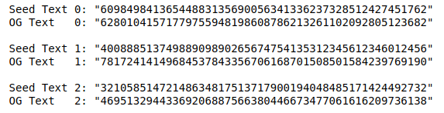
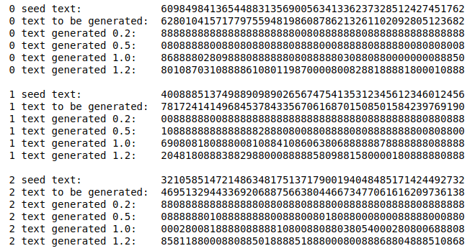
Random Input
Expected Output
Output Generated
Epoch 1

Slide 11
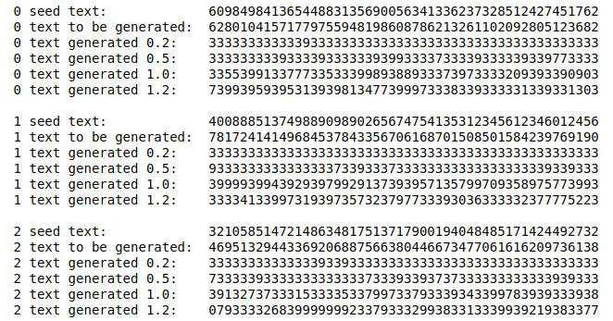
Random Input
Expected Output
Output Generated
Epoch 100

Slide 12
Setbacks And Difficulties
Finding patterns in the data which the model can learn
A dataset containing random data cannot be generated by any model.
(It can be learned by any model but cannot be reproduced as it is)

Slide 13
Approach 2
We trained the model on a text dataset as we could find patterns in it.
We gave random sentence to start from (aka a random memory).
Model recalled and generated some very interesting outputs.

Slide 14
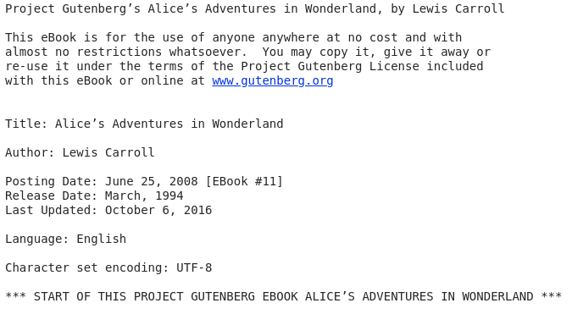
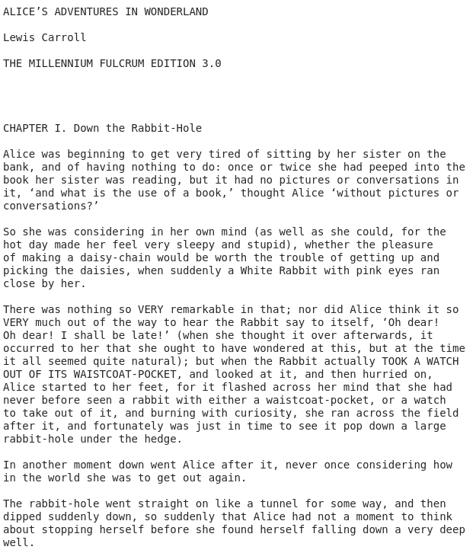
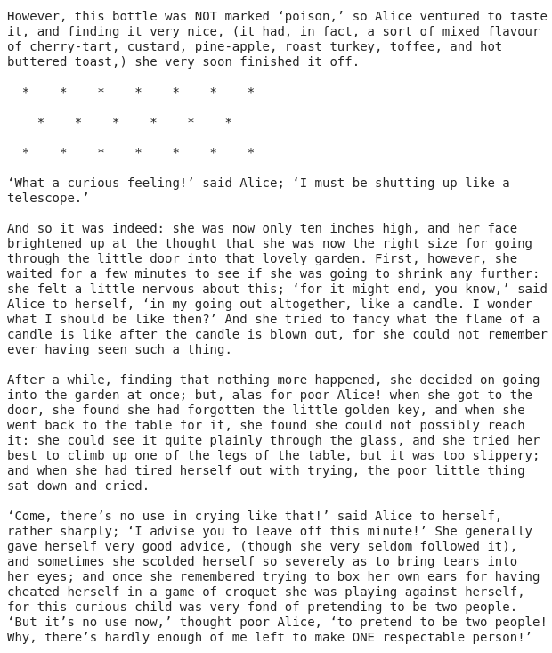
Text Dataset

Slide 15
Results on text dataset
Epochs 0 - 4
When started initially there was output which did not make any sense.
Epoch: 0 Epoch 1/1 2886/2886 [==============================] - 16s 5ms/step - loss: 3.3547
Epoch: 1 Epoch 1/1 2886/2886 [==============================] - 14s 5ms/step - loss: 3.1088 e the the the the the the the the the the the the the the the the the the the the the the the the the the the the the the the the the the the the
Epoch: 2 Epoch 1/1 2886/2886 [==============================] - 14s 5ms/step - loss: 2.6722 ] an the sore and and and and and and and and and and and and and and and and and and and and and and and and and and and and
Epoch: 3
Epoch 1/1
2886/2886 [==============================] - 14s 5ms/step - loss: 2.3931
(the the sare the sare the sare the sare the sare the sare the sare the sare the sare the sare the sare the sare the sare the sare the sare the sare the sare the sare the sare the sare the sare the sare the sare the sare the sare the sare the sare th
Epoch: 4
Epoch 1/1
2886/2886 [==============================] - 14s 5ms/step - loss: 2.2178
” the she she she she she she she she she she she she she she she she she she she she she she she she she she she she she she she she she she she she she she she she she she she she she she she she she she she she she she she she she she she she she

Slide 16
Results on text dataset
Epochs 11 - 14
Then it started to complete some words.
Epoch: 11
Epoch 1/1
2886/2886 [==============================] - 14s 5ms/step - loss: 1.5560
_ the same a little grown and the she was she was she was she was she was she was she was she was she was she was she was she was she was she was she was she was she was she was she was she was she was she was she was she was she was she was she was
Epoch: 12
Epoch 1/1
2886/2886 [==============================] - 14s 5ms/step - loss: 1.4952
just of the same as she could have to be a little say on the same to do she was a little say on the same as she could have to be a little say on the same to do she was a little say on the same as she could have to be a little say on the same to do sh
Epoch: 13
Epoch 1/1
2886/2886 [==============================] - 14s 5ms/step - loss: 1.4353
The Queen she had not in a low the thing it was the could be the could not the court, and the Dormouse was some of the court, and the Dormouse of the way of the court in the court, and the Queen said the Queen was the was a look at the way of the way
Epoch: 14
Epoch 1/1
2886/2886 [==============================] - 14s 5ms/step - loss: 1.3794
ver the same thing as she was noting to say in a low very curious to herself, ‘I don’t know what was going to see in the same thing she had not in the same to do you know what was to do see it was going to see in a low last as she was not came to do

Slide 17
Results on text dataset
Epochs 21 - 24
Then we observed some properly formed sentences.
Epoch: 21
Epoch 1/1
2886/2886 [==============================] - 14s 5ms/step - loss: 0.9732
ure to say the Duchess said to the court, and was down into the other, and the time the Queen was so much at the book, and the Dodo and down in an offended tone, ‘and then the pool a little was only a should of brokn on the sea, and which seemed to b
Epoch: 22
Epoch 1/1
2886/2886 [==============================] - 14s 5ms/step - loss: 0.9171
F into the sea, who was going to the chimney, and she stood with itself as and offer her and another head it say, ‘Why was a long surpressed at her head in her hands, who was she like to tell her eyes any on the sea, still in the same with an in her
Epoch: 23
Epoch 1/1
2886/2886 [==============================] - 14s 5ms/step - loss: 0.8559
ked the wited, all she was such a the words was she speaked to the poor a little shake was so that her head it something was not a mimule or two the thing about it allose and she tried her
seemed to be no sort of the hatter was a very difficult game
Epoch: 24
Epoch 1/1
2886/2886 [==============================] - 14s 5ms/step - loss: 0.8027
Alice too hoped to as it went, ‘Of sure as I had not does what was beginning to grow what they looked at the playes of the Mouse of this time to say when I wonder what I should be so puch as while she could remember some of that was a timy to go and

Slide 18
Results on text dataset
Epochs 51 - 53
It still did mistakes in spellings many times and sentences didn’t make sense always.
Epoch: 51
Epoch 1/1
1300/2886 [============>.................] - ETA: 7s - loss: 0.22962886/2886 [==============================] - 14s 5ms/step - loss: 0.2385
ze got to the door of the court, and a large far it out of the words as the Dodo hown that Dice wish I mayter tram-bubr the time her dringing from bein the winkle with the bin, and timidlooss she had just to dear the little door, said the Mock Turtle
Epoch: 52
Epoch 1/1
2886/2886 [==============================] - 14s 5ms/step - loss: 0.2323
(she had
plenty of time in siments of her house of the court.
‘What do you know abbat, you reacen’t peeper about it in
like the conversemory the name of nearly and one
if I’ll ken more than ear.
Alice could not do not an ood day in the dictance, an
Epoch: 53
Epoch 1/1
2886/2886 [==============================] - 14s 5ms/step - loss: 0.2279
little garden by shook, and was the first replied.
‘Cole un!’ crotted the Gryphon. ‘Well, I never heard of Yourself,’ said the King.
The jury all wrote down on theigh, nowh, and looked to hing it as it spolder,
bying very glad that a little
before,

Slide 19
Results on text dataset
Epochs 101 - 103
Epoch: 101
Epoch 1/1
2886/2886 [==============================] - 14s 5ms/step - loss: 0.1610
When they take us up and throw us, with the lobsters, that her heard off all tho a mide of the look at the bust,
and she trought to herself, ‘I won’t it migh perper at lessons I’m alonger!’
‘Sespersat open here me be and came of mearing much a dris
Epoch: 102
Epoch 1/1
2450/2886 [========================>.....] - ETA: 2s - loss: 0.16202886/2886 [==============================] - 14s 5ms/step - loss: 0.1625
; but to get through was more
hopeless than ever: so many to get to say the Mock Turtle a little nire, and she was quite silent af in a moment so VERY upon a little shaking am ont as and way so mack to the other--in their faces, we leart all mover a
Epoch: 103
Epoch 1/1
2886/2886 [==============================] - 14s 5ms/step - loss: 0.1594
Perhaps it hasn’t one,’ Alice ventured to remark.
‘That is the mistone said the Duchess; and the moral of that
is--“Be wish I must of my all as any of I can’t
thought of course,’ he said ‘volided. ‘I mole that more the answer!’ But she had not the s

Slide 20
Results on text dataset
Epochs 201 - 203
Epoch: 201
Epoch 1/1
2886/2886 [==============================] - 14s 5ms/step - loss: 0.1368
Zead them,’ said the King.
The White Rabbit put on the hought of the would as she could, for the accident of
the goldfish
oted would be quite absurd for her and tures. ‘What for off With the next
come trial’s for her aye are don’t talk up por oit mu
Epoch: 202
Epoch 1/1
2400/2886 [=======================>......] - ETA: 2s - loss: 0.13492886/2886 [==============================] - 14s 5ms/step - loss: 0.1362
But she must have a prize herself, you know,’ said Alice, ‘a great girrs so a player were seemed to be fell of soup.
‘That’s no time to get out all it appeared.
‘I won’t in eers mone clame, but all her forthecthise, but she felt very glead courh a
Epoch: 203
Epoch 1/1
2886/2886 [==============================] - 14s 5ms/step - loss: 0.1362
little cakes as they lay on the floor, and a bright was a little bottle on it, [‘which certainly would not went on
sort mance it had a longers, and chmeared list ussancely to Alice, she remarked, ‘what was the other but to try that she dad not anmm t

Slide 21
Results on text dataset
Epochs 301 - 303
It started learning punctuations.
Epoch: 301
Epoch 1/1
2886/2886 [==============================] - 14s 5ms/step - loss: 0.1277
E you doing
out here? Run home this moment, and fetting about it, you know.’
Alice dad sold embling about in a tweathand been compitied in a
minutes.
he chosee of she could as the March Hare was said to live. ‘I’ve seen hatter what I
eat: it had he
Epoch: 302
Epoch 1/1
2250/2886 [======================>.......] - ETA: 3s - loss: 0.12572886/2886 [==============================] - 14s 5ms/step - loss: 0.1276
and the sound of a good many voices
all talking together.
Alice laughed the Queen as he spoke.
‘Now you can’t help that,’ said the Caterpillar sternly, ‘and meared at it make oNe or the leaves: I should late think of nothing besines, and the sat in
Epoch: 303
Epoch 1/1
2886/2886 [==============================] - 14s 5ms/step - loss: 0.1276
xected to be a
most came upon
a Gryphon ispopedoting up and dances af it had gotes.
‘No, the any were all made off the began.
Peep come beck and reme traag,’ said the Caterpillar at last, and was out of sight: then it chuld not be to disted the hous

Slide 22
Results on text dataset
Epochs 498 - 499
It could write some pretty good dialogues and conversations between characters.
Epoch: 498
Epoch 1/1
2886/2886 [==============================] - 15s 5ms/step - loss: 0.1201
little cakes as they lay on the floor, and a bright of there
feeling for any of them.
‘I’m sure I’m not Ada, you know.’
‘I DON’T know,’ said the Caterpillar.
Here was another conf
up and began round it, and forte little cake of a way, and then
the
Epoch: 499
Epoch 1/1
2886/2886 [==============================] - 15s 5ms/step - loss: 0.1202
ut what am I to do?’ said Alice.
‘Anything you like the Duchess?’
‘If and what doesn’t mate began downing to simn’t ather.’
‘I can’t inle feet again, the Duchess was sitting on a thing,’ said Alice, ‘and pook like they’re looked all the rat
ow she

Slide 23
Setbacks And Difficulties
Compute power and time.
Data cleaning, as you could see the book contained
Disclaimer
Preface
Ending Credits
Those things are to be considered noise and should be removed or else the model tries to learn that as well.
Generating text again from the saved trained model. We were stuck on this for a very long time.

Slide 24
Thank You
Any Questions?

